Slide 1


Trade Fair Stall Booking System
Presented By : Prince Pratapsinh Thakur
: Keval Girishbhai Patel
Under Guidance By : Dr. Saziya Saiyed

Slide 2

System Requirement
Frontend :- Html , CSS , JavaScript , React JS(Vite)
Backend :- Node JS With Express JS
Database :- MongoDB

Slide 3
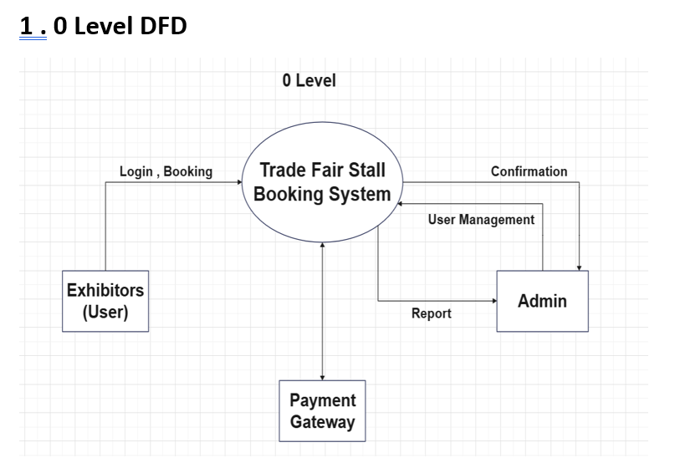

Diagrams

Slide 4
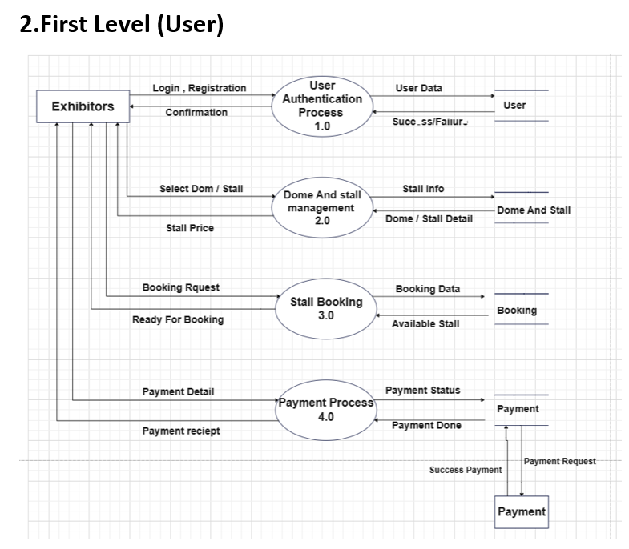


Slide 5
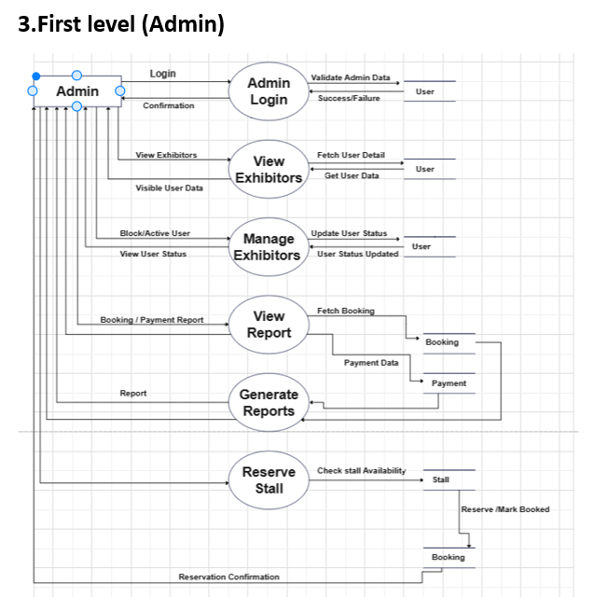


Slide 6
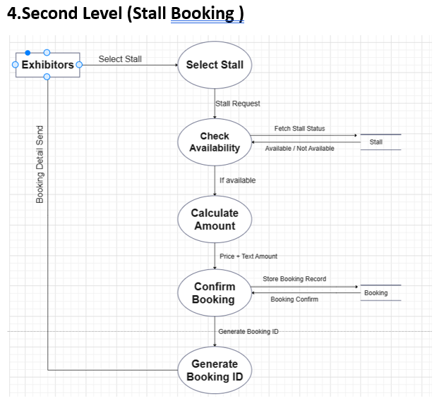


Slide 7
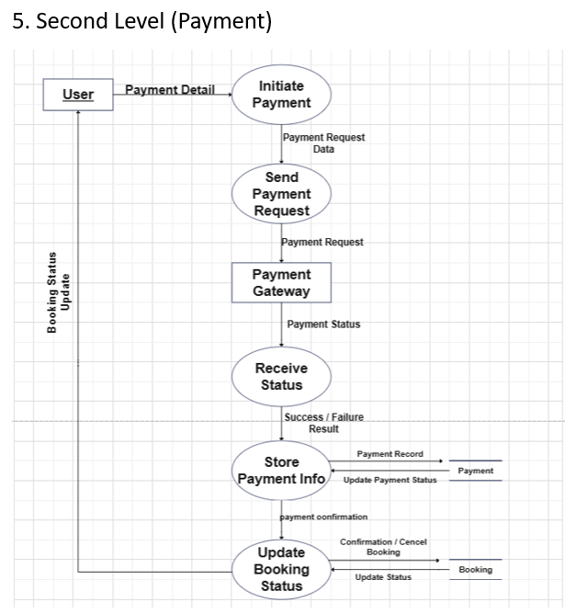


Slide 8
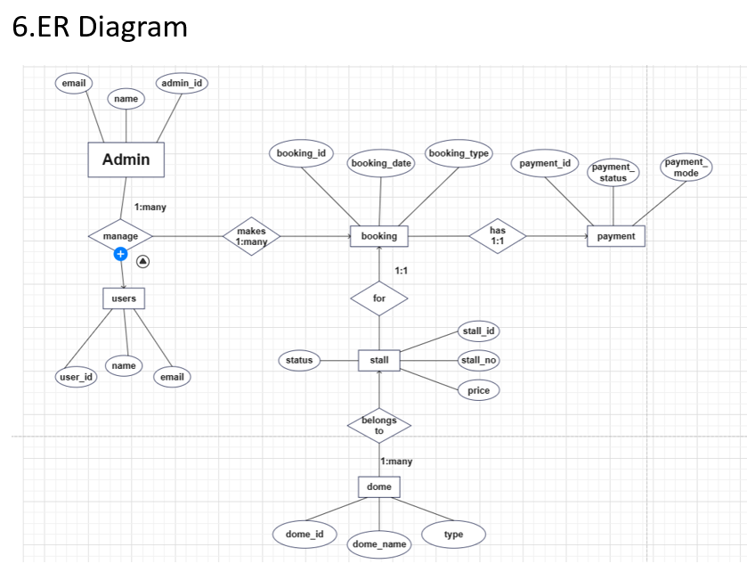


Slide 9
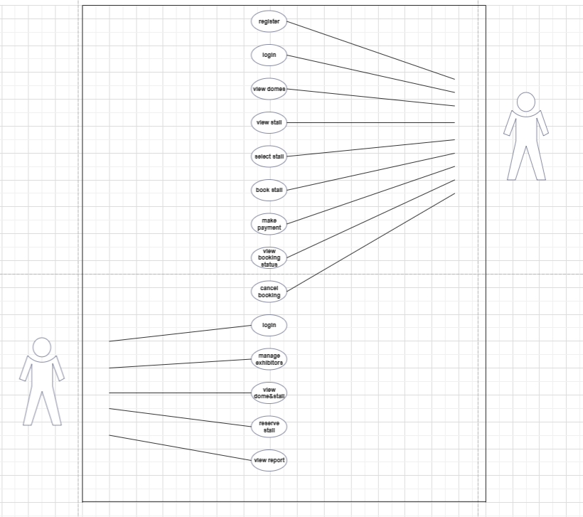

Use Case:
User
Admin

Slide 10
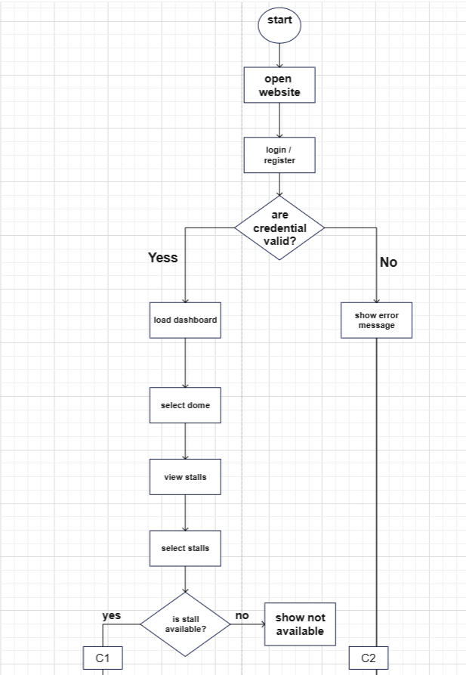
UML Activity Diagram

Slide 11
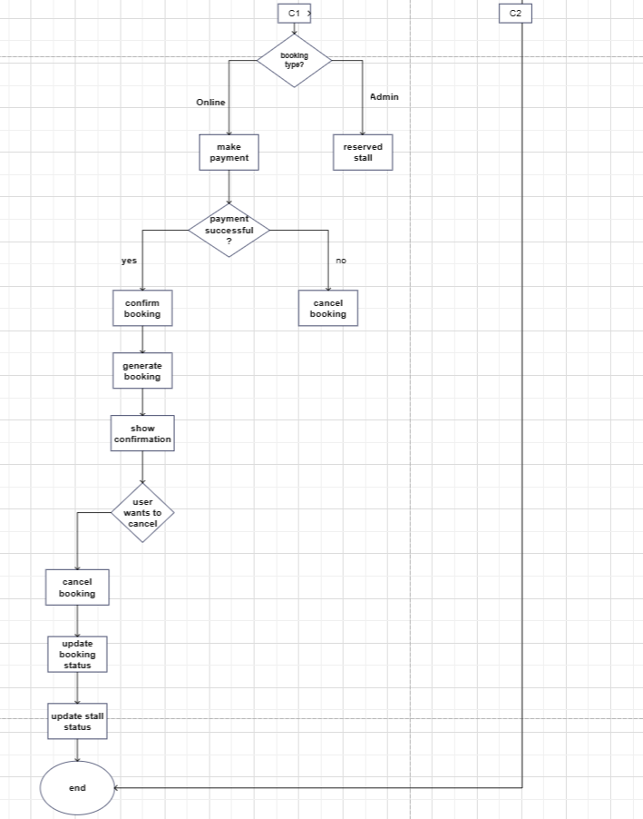

Slide 12
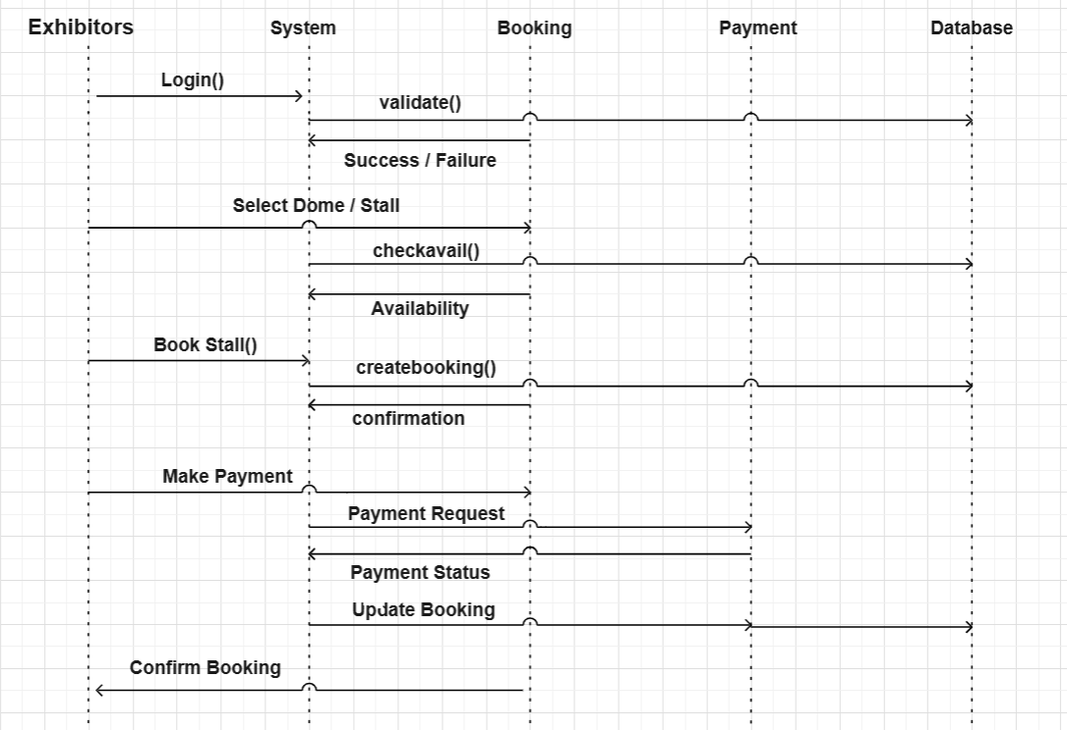
UML Sequence Diagram

Slide 13

Users Collection :
The Users collection stores information about all registered users in the system. It includes personal details such as the user's full name, company name, email address, and contact number. This collection also manages user authentication by storing encrypted passwords and defines user roles such as USER, ADMIN, and SUPER_ADMIN to control system access.
Data Dictionary
SR.No | Column Name | Data Type | Size | Constraint | Description
1 | _id | ObjectId | 24 chars | Primary Key, Auto | Unique user ID
2 | fullname | String | Variable | Required | Full name of user
3 | company | String | Variable | Required | Company name
4 | email | String | Variable | Required, Unique | User login email
5 | phone | String | Variable | Required | Contact number
6 | password | String | Variable | Required | Encrypted password
7 | role | String | Up to 11 | Enum(USER,ADMIN,SUPER_ADMIN) | User access role
8 | createdAt | Date | - | Auto timestamp | Record creation time
9 | updatedAt | Date | - | Auto timestamp | Last update time

Slide 14

Domes Collection :
The Domes collection stores information about exhibition domes available in the trade fair. Each dome record contains the dome name, location, description, image, and status indicating whether the dome is active or inactive. Domes act as the main containers where stalls are created and managed.
SR.No | Column Name | Data Type | Size | Constraint | Description
1 | _id | ObjectId | 24 chars | Primary Key | Unique dome ID
2 | domeName | String | Variable | Required | Name of dome
3 | location | String | Variable | Required | Dome location
4 | description | String | Variable | Optional | Dome details
5 | image | String | Variable | Optional | Dome image path
6 | status | String | Up to 8 | Enum(ACTIVE,INACTIVE) | Dome status
7 | createdAt | Date | - | Auto timestamp | Record creation time
8 | updatedAt | Date | - | Auto timestamp | Last update time

Slide 15

Stalls Collection:
The Stalls collection stores details of all stalls available within different domes. Each stall is associated with a specific dome and includes information such as stall number, position inside the dome layout, price, and availability status. This collection helps manage stall allocation and availability during the trade fair.
SR.No | Column Name | Data Type | Size | Constraint | Description
1 | _id | ObjectId | 24 chars | Primary Key | Unique stall ID
2 | stallNumber | String | Variable | Required | Stall number
3 | dome | ObjectId | 24 chars | FK -> domes | Dome reference
4 | side | String | Up to 6 | Enum positions | Stall position
5 | price | Number | - | Min 0 | Stall price
6 | status | String | Up to 9 | Enum status | Availability
7 | createdAt | Date | - | Auto timestamp | Record creation time
8 | updatedAt | Date | - | Auto timestamp | Last update time

Slide 16
Bookings Collection :
The Bookings collection stores records of stall booking requests made by users. It connects users, stalls, and domes together and stores booking information such as payment amount, Aadhaar verification reference, and booking status. This collection helps track whether a booking is pending, approved, rejected, or cancelled.
SR.No | Column Name | Data Type | Size | Constraint | Description
1 | _id | ObjectId | 24 chars | Primary Key | Unique booking ID
2 | user | ObjectId | 24 chars | FK -> users | User reference
3 | stall | ObjectId | 24 chars | FK -> stalls | Booked stall
4 | dome | ObjectId | 24 chars | FK -> domes | Dome reference
5 | amount | Number | - | Optional | Booking amount
6 | aadhaarVerification | ObjectId | 24 chars | Required FK | Aadhaar verification
7 | status | String | Up to 9 | Enum booking status | Booking state
8 | createdAt | Date | - | Auto timestamp | Record creation time
9 | updatedAt | Date | - | Auto timestamp | Last update time

Slide 17

Aadhaar Verifications Collection:
The Aadhaar Verifications collection stores Aadhaar verification details submitted by users before booking a stall. It includes the Aadhaar name, encrypted Aadhaar number, uploaded Aadhaar image, and verification status. This collection ensures identity verification and improves security in the stall booking process.
SR.No | Column Name | Data Type | Size | Constraint | Description
1 | _id | ObjectId | 24 chars | Primary Key | Verification ID
2 | user | ObjectId | 24 chars | FK -> users | User reference
3 | aadhaarName | String | Variable | Required | Name on Aadhaar
4 | aadhaarNumber | String | 12 digits | Encrypted | Aadhaar number
5 | aadhaarImage | String | Variable | Required | Uploaded image
6 | verified | Boolean | 1 | Default false | Verification result
7 | submittedAt | Date | - | Default Date.now | Submission date
8 | createdAt | Date | - | Auto timestamp | Record creation time
9 | updatedAt | Date | - | Auto timestamp | Last update time

Slide 18
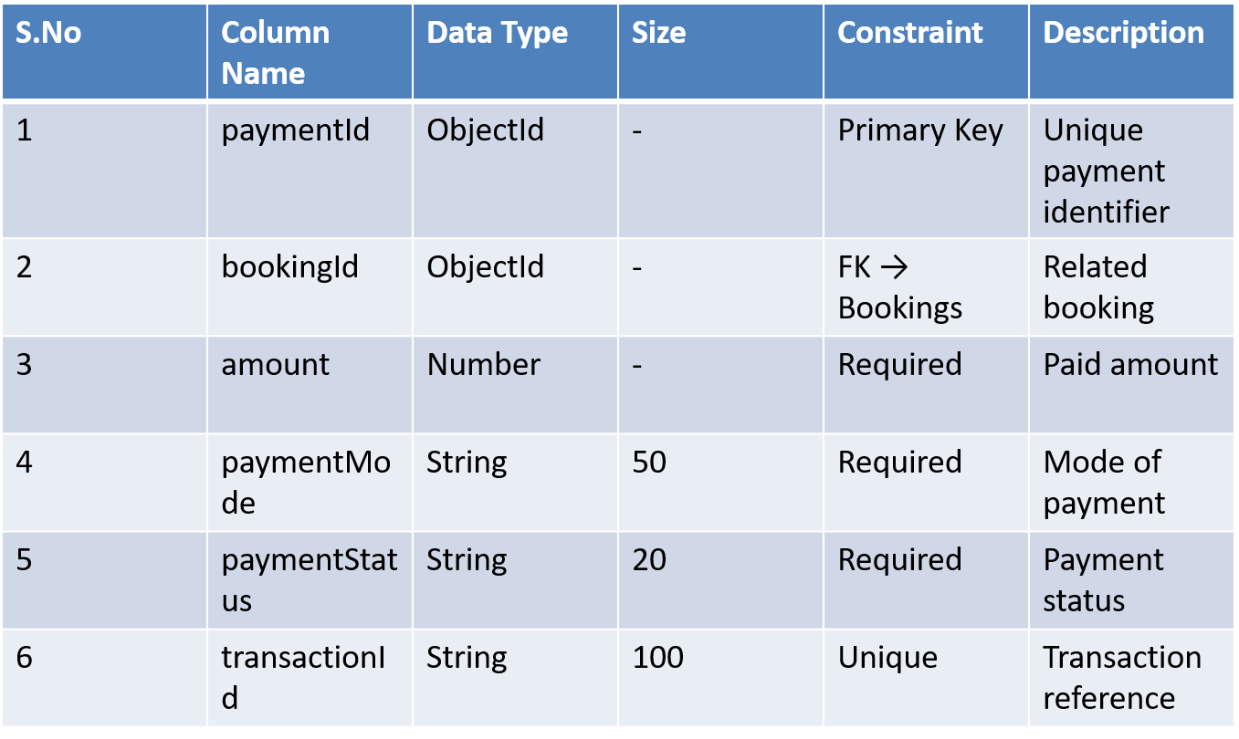
Payments Collection :
Stores payment details related to stall bookings including amount, method, and payment status . Each booking has one payment record.

Slide 19
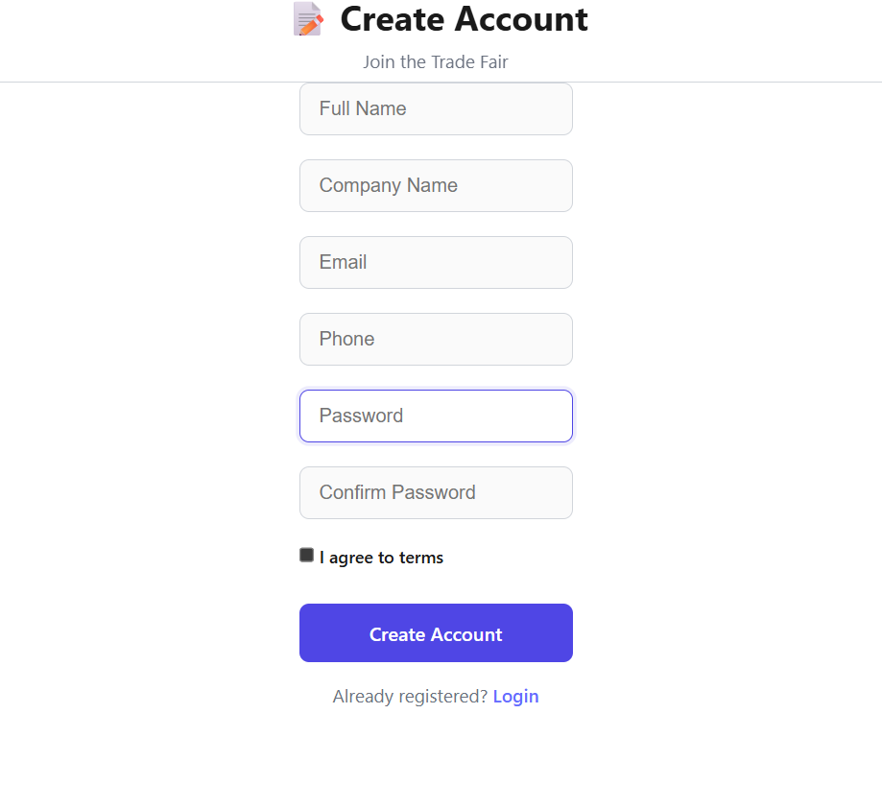

UI

Slide 20
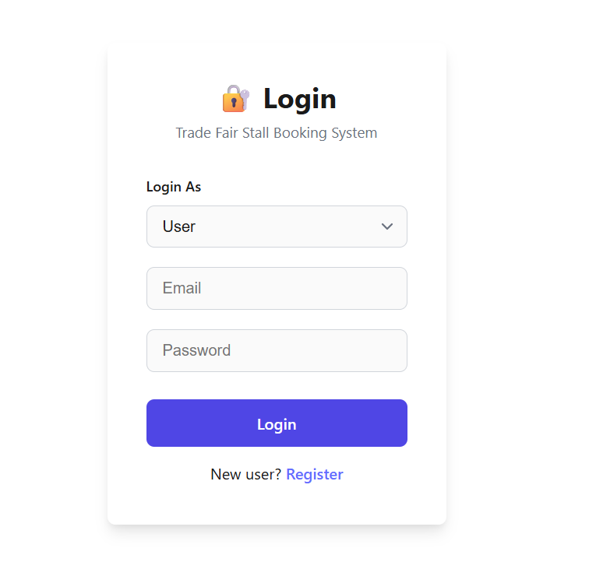


Slide 21
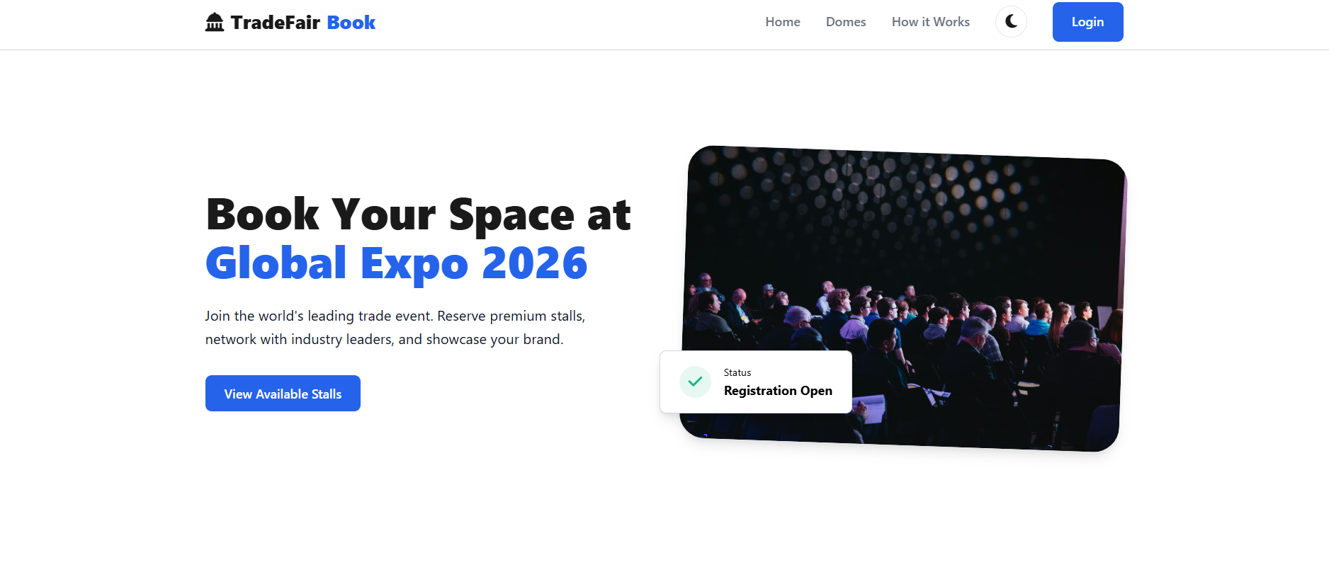


Slide 22
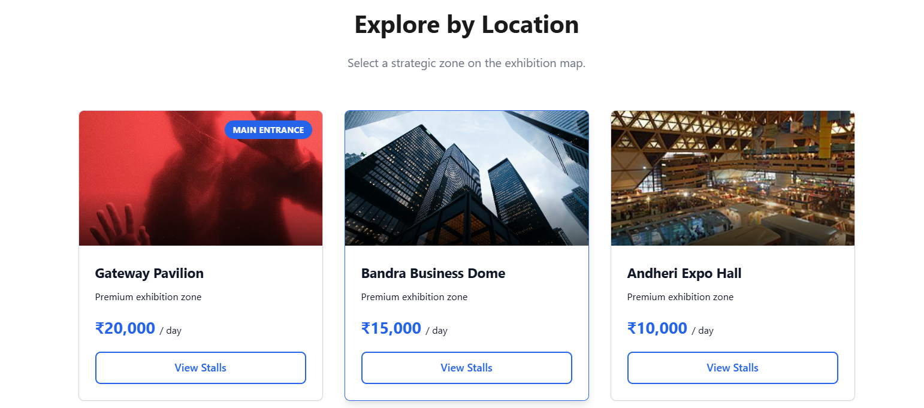


Slide 23
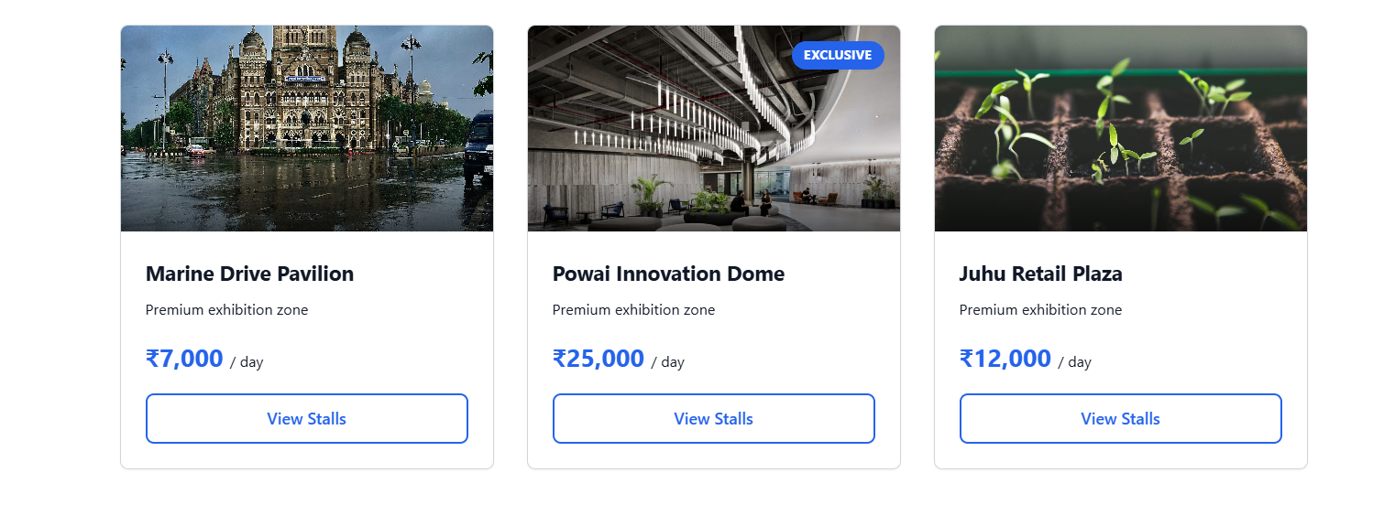


Slide 24
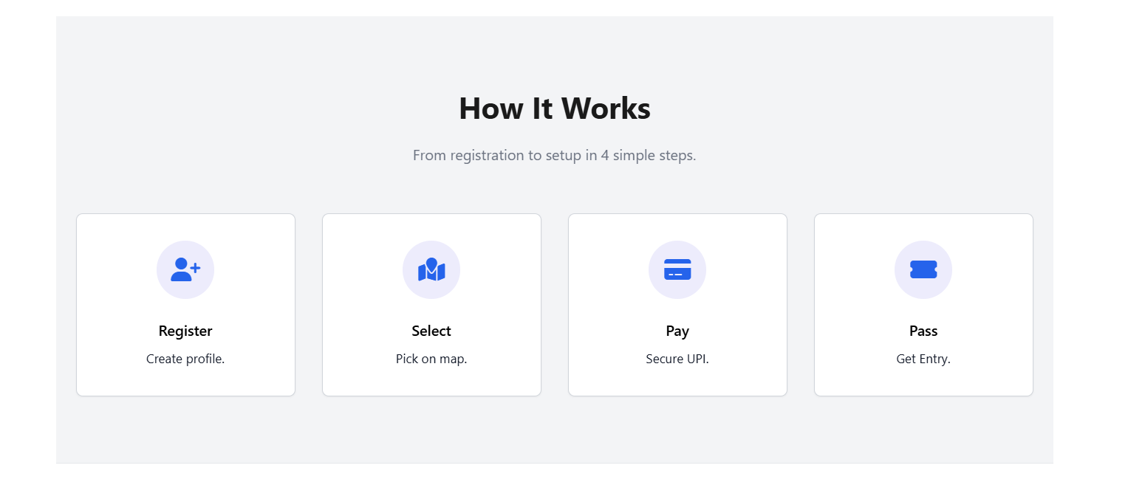


Slide 25


Tools & Technology
Frontend:-
HTML , CSS , JavaScript , React JS , React Router DOM
Backend:-
Node.js , Express.js , bcryptjs (Password hashing)
Database:-
MonogoDB , MongoDB ODM
Development Tools:-
Visual Studio Code , Postman (API Testing)

